Slide 1
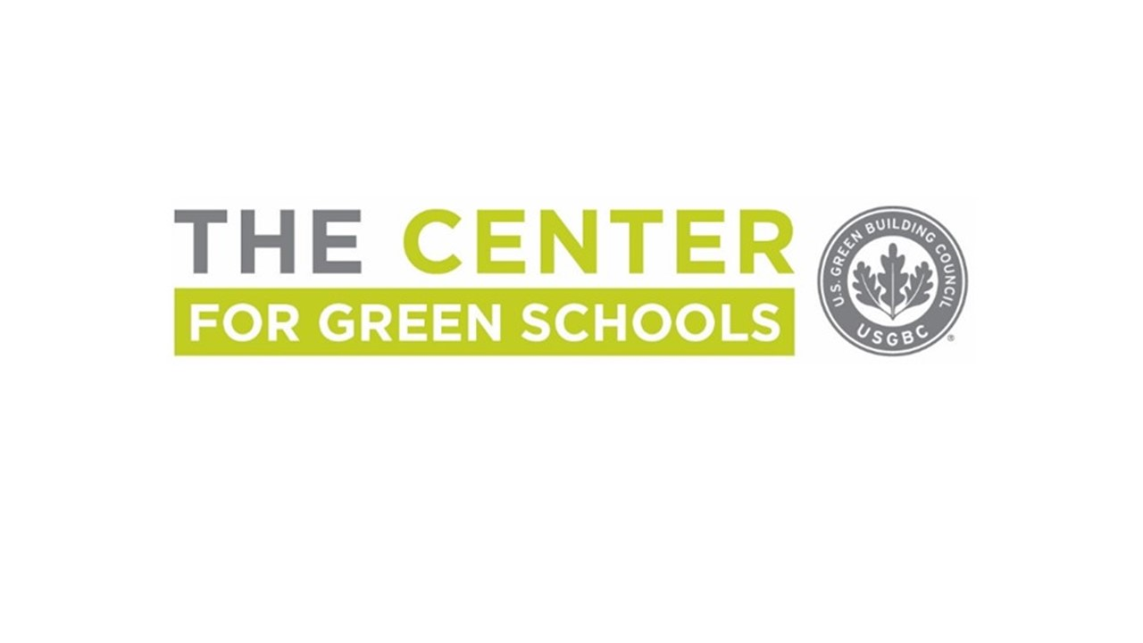
Notes:
The Center for Green Schools is part of the U.S. Green Building Council, a 501c3 non-profit dedicated to transforming the way buildings and communities are designed, built and operated, enabling an environmentally and socially responsible, healthy, and prosperous environment that improves the quality of life. The Center for Green Schools believes that all students deserve the opportunity to attend schools that sustain the world they live in, enhance their health and well-being, and prepare them for 21st century careers.

Slide 2
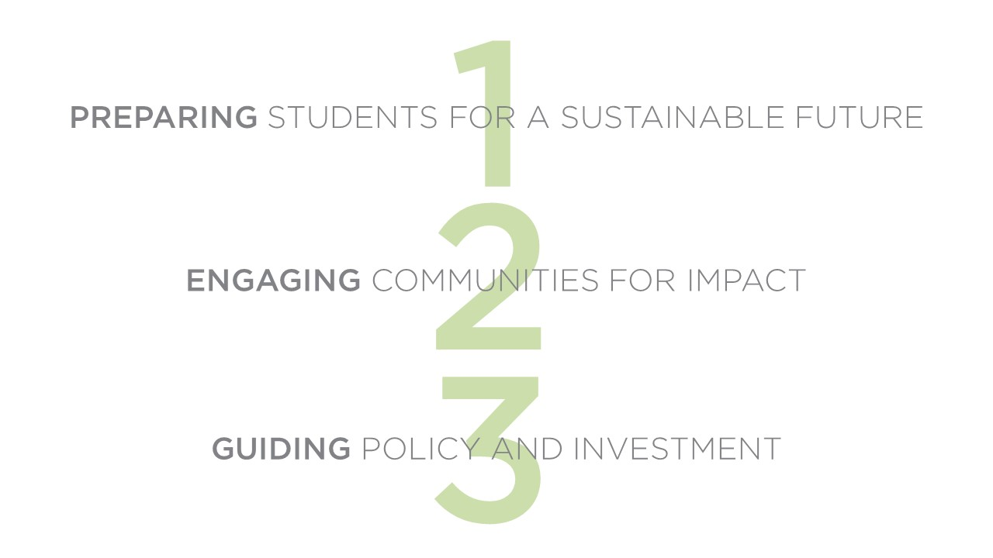
Notes:
The top goals of the Center for Green Schools are to prepare students to lead a sustainable future, engage communities for impact at their local schools,, and guide public policy and investment to prioritize healthy and sustainable schools for all children.

Slide 3
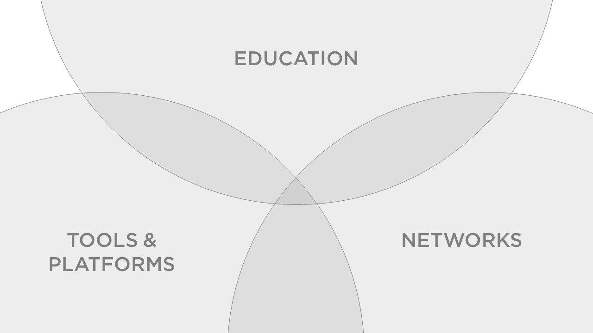
Notes:
To achieve our goals, the Center focuses on providing educational resources for students, teachers, staff, and building industry professionals; continuously improving tools and platforms to give schools a way to track their progress and gain buy-in; and convening the most critical stakeholders in driving change at schools and school districts so that they can learn from each other and plan their next steps.

Slide 4
Notes:
We’ll now walk through these three areas and give some examples of the Center for Green Schools’ work. Through our educational resources, we help professionals who work within schools and supporting schools find what they need to do their work more sustainably and incorporate sustainability into their work with students.

Slide 5
Notes:
Building Learners is the Center’s core offering for educators and schools. It brings together all of the educational resources that we’ve developed for the classroom into one offering, providing a K12 education program that connects student learning with the operations of a school building and prepares them to succeed in 21st century green careers that value systems thinking and problem-solving. With Building Learners, a school gets access to the Arc building benchmarking platform, the Learning Lab online platform for sustainability curriculum, the Green Classroom Professional Certificate program, and hands-on support to incorporate their school building into student learning.

Slide 6
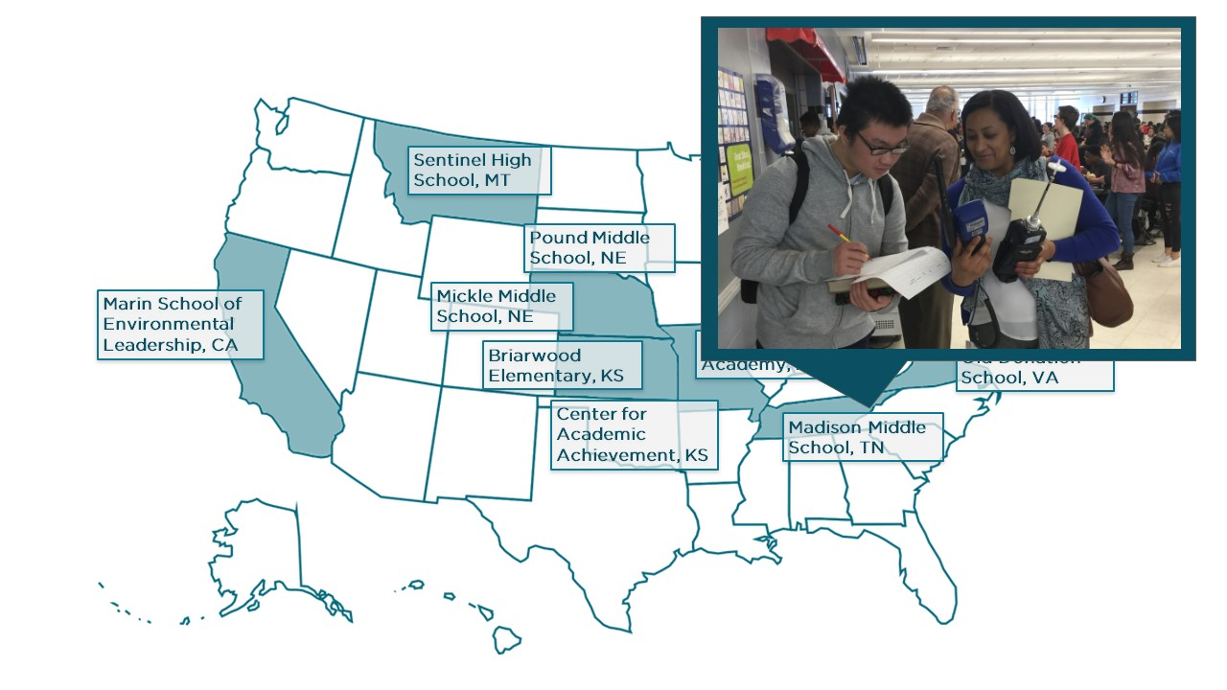
Notes:
A couple of examples from schools that have piloted Building Learners:
With a focus on human experience - in Nashville, a science teacher led her students in air quality testing in their school building

Slide 7
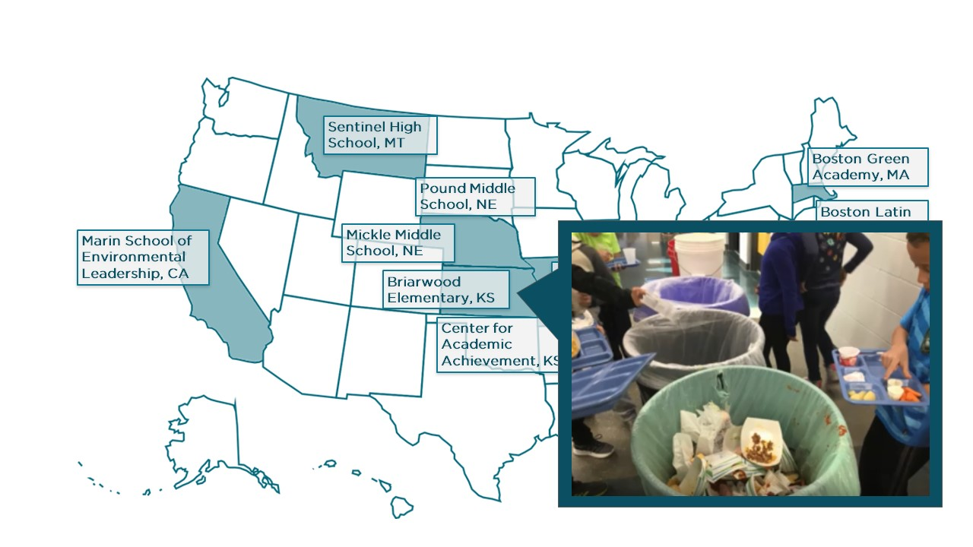
Notes:
A couple of examples from schools that have piloted Building Learners:
With a focus on waste - students at Briarwood Elementary in Kansas organized a school-wide zero food waste challenge, creating signage and instructions for students to follow after lunch

Slide 8
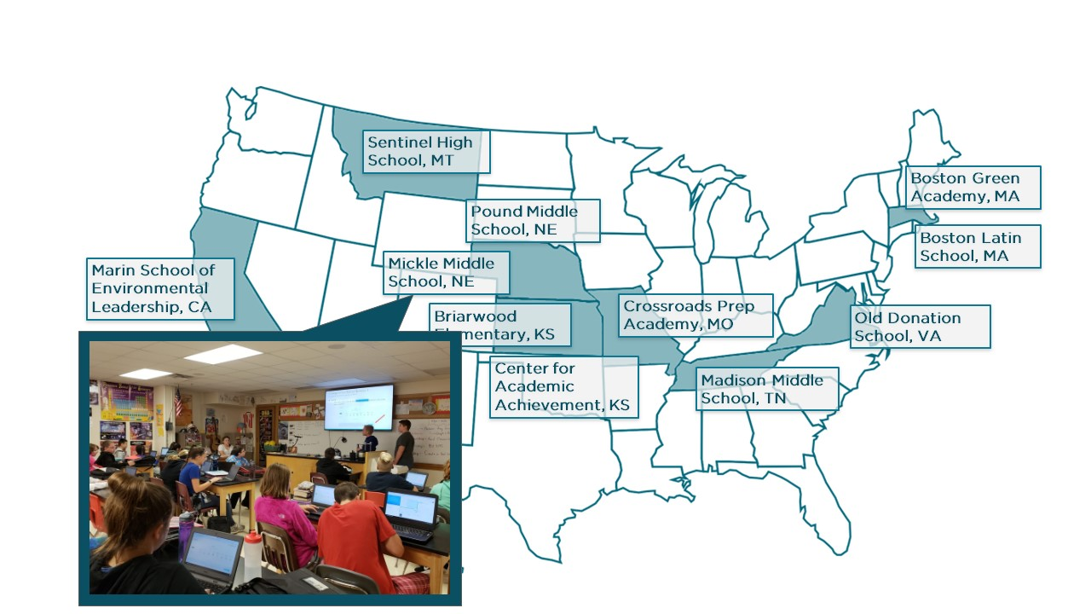
Notes:
A couple of examples from schools that have piloted Building Learners:
With a focus on transportation - 7th graders in Lincoln guided 605 of their fellow students through a survey to assess the collective impact of their transit to school.

Slide 9
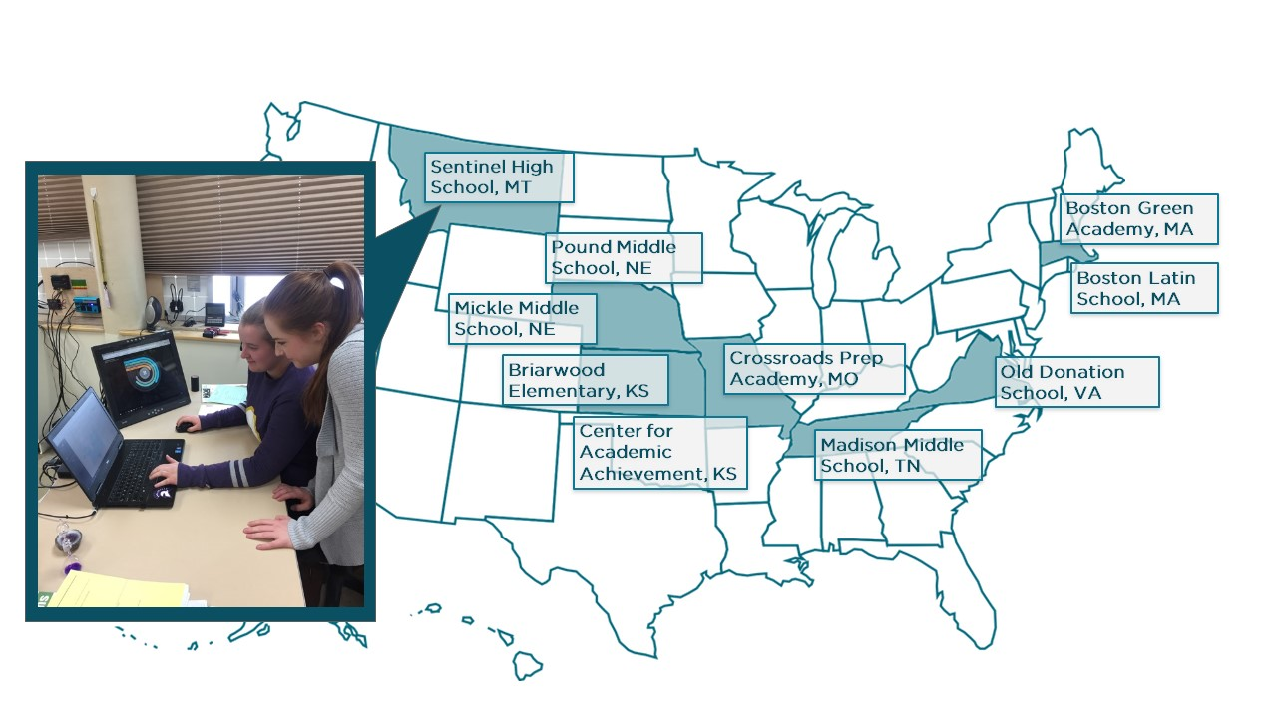
Notes:
A couple of examples from schools that have piloted Building Learners:
And wanting to focus on overall performance, the student EcoClub at Sentinel High in Missoula are collecting and inputting data in all 5 arc categories. They are communicating their score and their efforts to be more green throughout the school and community, including in their display case, at local conferences, and to the school board..

Slide 10
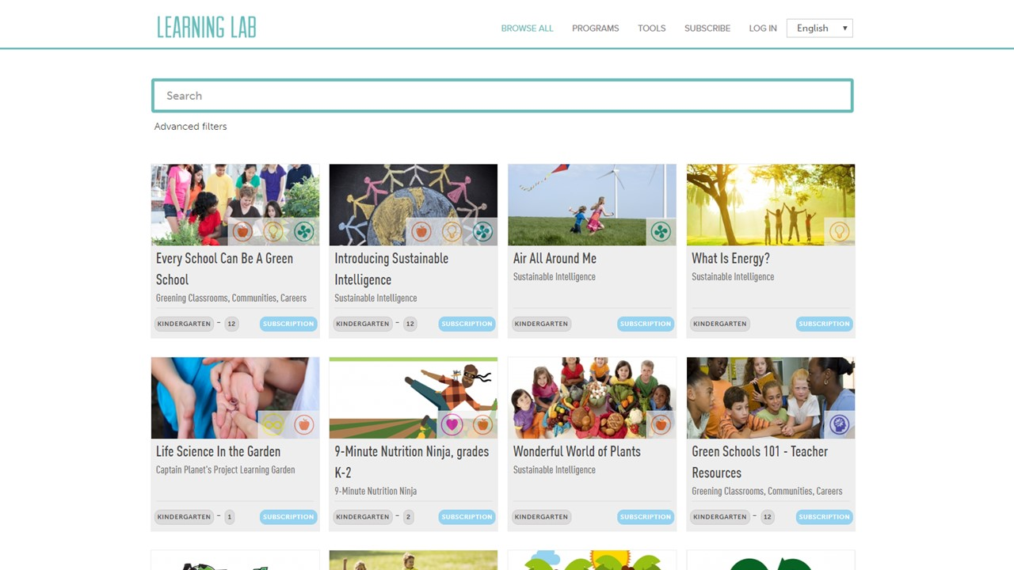
Notes:
Learning Lab can be used as part of Building Learners or on its own. It is an online platform for K-12 teachers that hosts high-quality, standards-aligned lessons in a full range of sustainability topics to help teachers incorporate sustainability content into classroom learning. As of May 2019, the platform hosted almost 600 lessons in English and Spanish from 15 partner organizations.

Slide 11
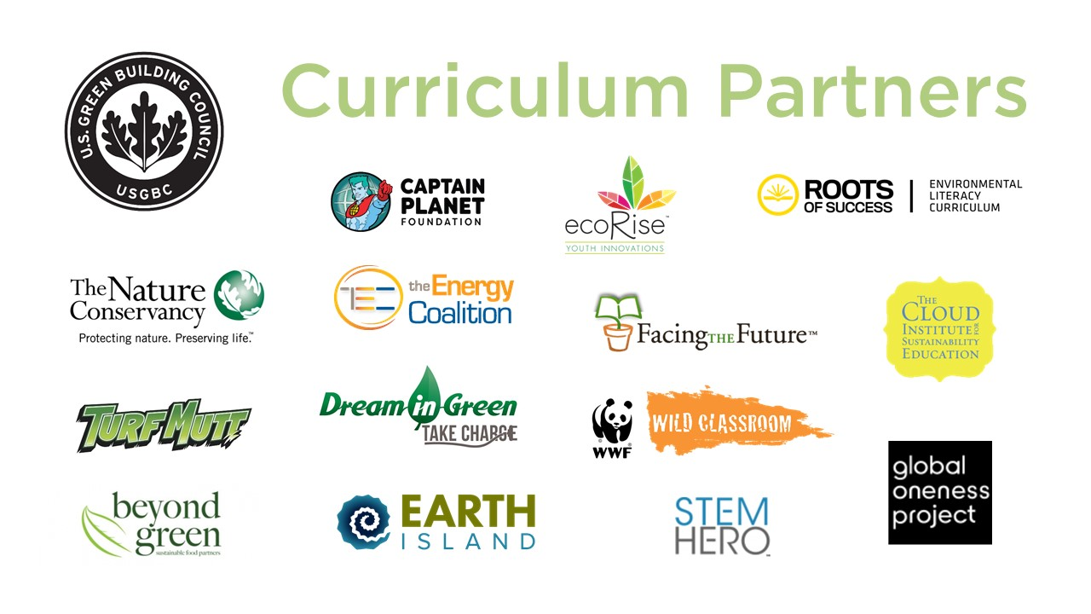
Notes:
Not only does Learning Lab provide an important place for educators to find what they need for their classroom, it also provides a platform for the top providers of sustainability education to work together and share their priorities for future curriculum development, professional development, and outreach.

Slide 12
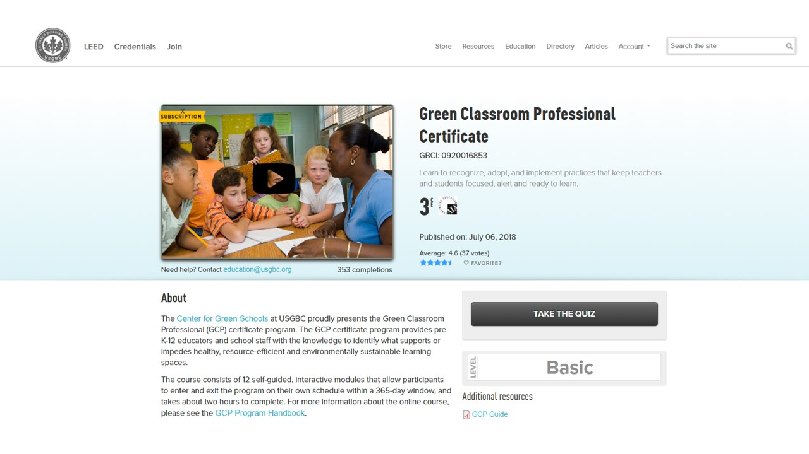
Notes:
The Green Classroom Professional Certificate program can also be accessed either with the Building Learners program or on its own. It provides pre K-12 educators and school staff with the knowledge to identify what supports or impedes healthy, resource-efficient and environmentally sustainable learning spaces. The course consists of 12 self-guided, interactive modules that allow participants to enter and exit the program on their own schedule within a 365-day window, and takes about two hours to complete.

Slide 13
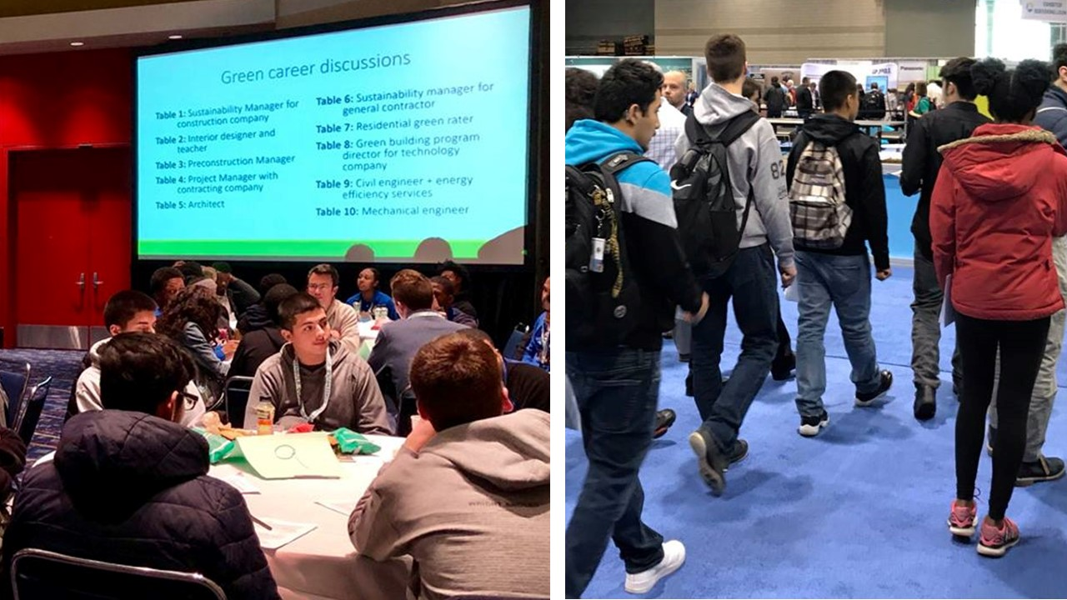
Notes:
For those familiar with the International Greenbuild Conference & Expo, the Center runs programming at the event to help local high school students learn from attendees and discuss their future green career opportunities. This is a great opportunity for both the students and USGBC Member companies, who value interacting with young people who are interested in joining their industries.

Slide 14
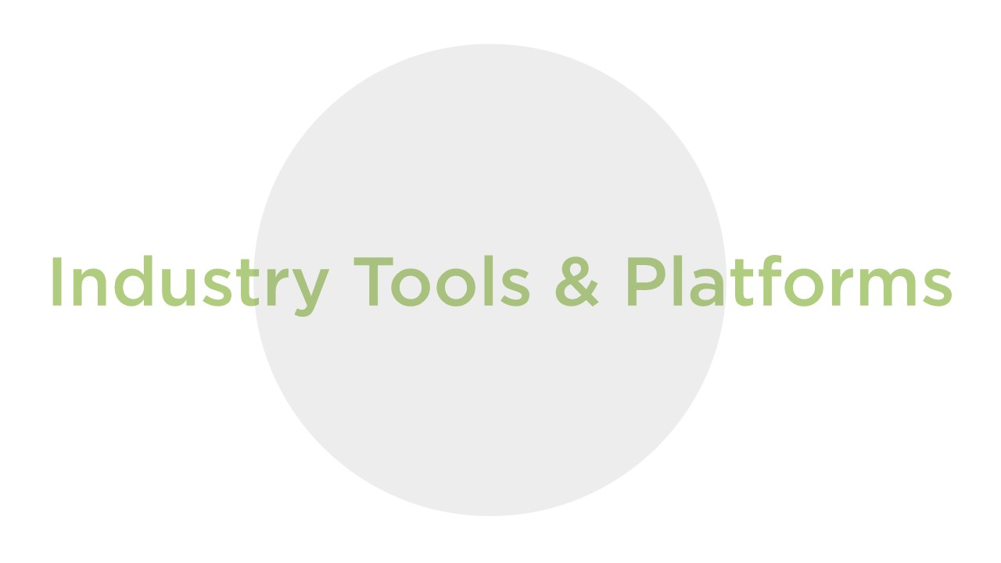
Notes:
Through our industry-recognized tools and platforms, the Center gives schools powerful ways to track their progress and catalyze additional commitment around sustainability.

Slide 15
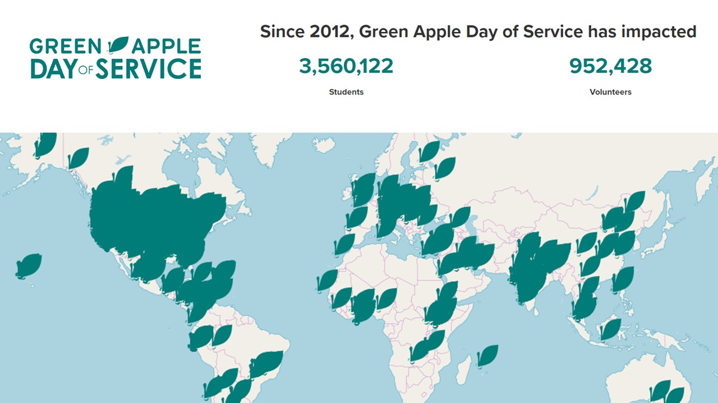
Notes:
One of our best-loved programs is Green Apple Day of Service, which has served over 3.5 million students with the work of almost 1 million volunteers since 2012. Green Apple Day of Service is a unique international moment to join schools across the world to celebrate the central role that schools play in preparing the next generation of global leaders. Each school’s Green Apple project strengthens the relationship between community volunteers and their schools as they join together around the common goals of healthy, vibrant, and sustainable communities. The Day of Service is a key opportunity to give students hands-on experience with sustainability, strengthening civic leadership, environmental literacy, and project management skills in the process.

Slide 16
Notes:
The Center makes sure that the platforms that USGBC has developed and uses are excelling at meeting the needs of schools and school districts. Most notably, this includes Arc and LEED. Arc is the sustainability benchmarking platform that allows users to track energy, water, waste, transportation, and human experience in their building, benchmark it against carbon emissions goals and neighboring buildings, and communicate performance to occupants through a simple score and visual. The Center has worked with Arc to create tools specifically for schools, including the benchmarking lessons used in the Building Learners program and an online “playground” for users to explore the platform for free.

Slide 17
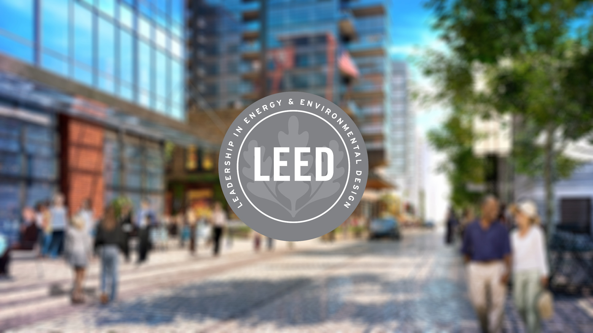
Notes:
LEED is the most widely used green building rating system in the world. Available for virtually all building, community and home project types, LEED provides a framework to create healthy, highly efficient and cost-saving green buildings, and the Center works to ensure that it works well in the context of K-12 schools. LEED certification is a globally recognized symbol of sustainability achievement.

Slide 18
Notes:
The green building and green schools movements are driven by people who care about the future of our planet and the health of their families and neighbors. The Center helps green school champions connect with each other so that they can make an even greater collective impact.

Slide 19
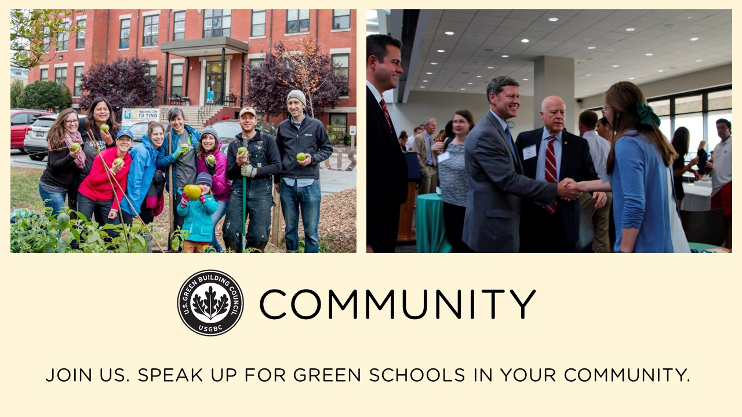
Notes:
USGBC members around the country, both individuals and companies, fuel green school action in their communities, and we help connect them together across USGBC communities.

Slide 20
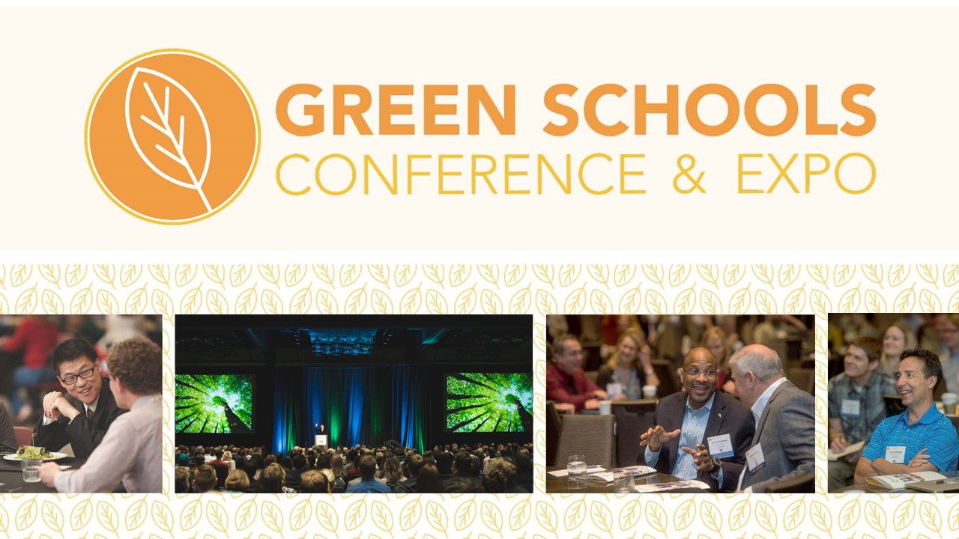
Notes:
One of the ways we empower volunteers, school staff, teachers, and students is through the annual Green Schools Conference & Expo, which attracts 1,000 people each year, inspiring them and giving them opportunities to learn new strategies for furthering green schools in their areas.

Slide 21
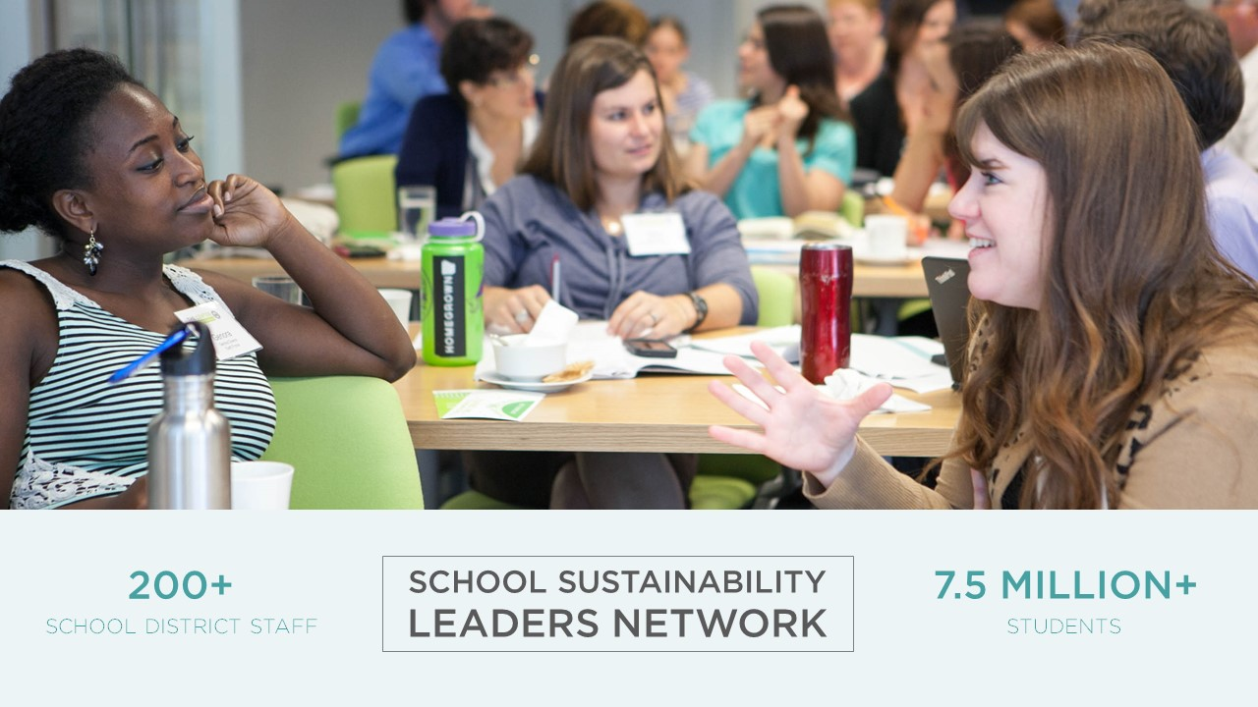
Notes:
One of the powerful group of change agents that the Center has gathered together for almost a decade are school district staff who are in charge of sustainability for their school systems. This group sets policy and lays the groundwork for new practices in some of the largest school systems in the U.S. Their efforts impact millions of students and can have huge impact on the cities and towns in which they work.

Slide 22
Notes:
Our nation’s leaders on the federal level also need a platform to share ideas and gain valuable information to support green schools through public policy. The Center for Green Schools supports the bi-partisan Congressional Green Schools Caucus in the U.S. House of Representatives by providing resources, connections and up-to-date research to improve school environmental sustainability, occupant health and sustainability literacy.

Slide 23
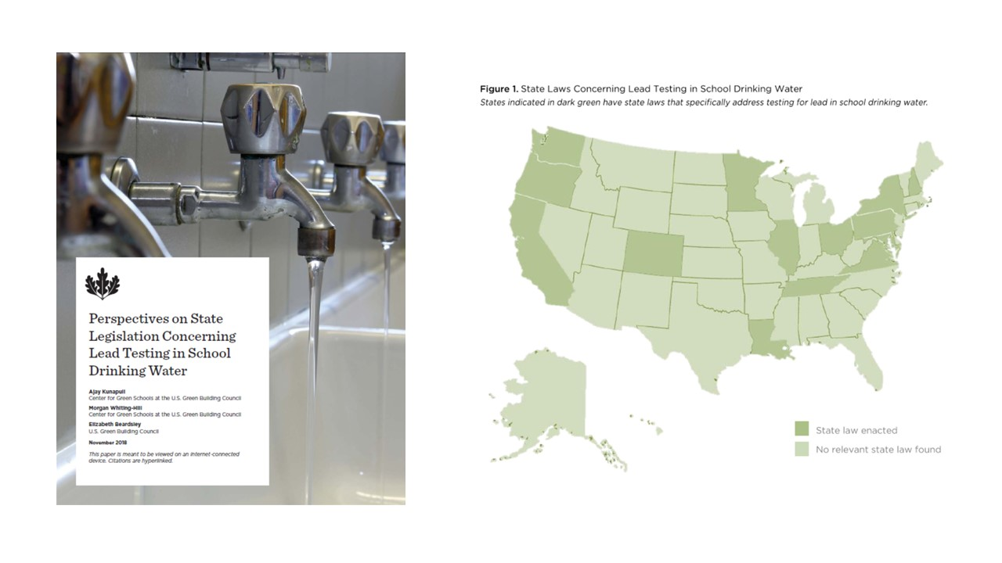
Notes:
On the state level, several hundred state lawmakers have signed up to receive information and research from the Center and USGBC about public policy to support green schools and communities. Each year, the Center releases new research for this group regarding current state-level policies that support greener schools. In 2018, this research examined state-level laws concerning lead testing in school drinking water, exploring the elements of the laws, their implementation, and indications of their effectiveness.

Slide 24
Notes:
Schools should show our kids the best opportunities the world holds for them, but in many of our communities, they don’t. Instead, our kids watch as the outdated technology around them wastes time and natural resources; they see pollution, mold, and peeling paint that can make them sick; and they struggle to connect what they’re learning to the pressing problems they see in their community. USGBC has 25 years of experience giving people the clarity they need to go out and make a difference. The Center for Green Schools brings focus and a proven history of results in providing high-quality education for teachers, students and school staff; clear guidance for sustainability action; and strong networks to help people find solutions.

